Slide 1
Vaping & E-cigarettes
Think About It
Notes:
Hello, my name is _____. I am from ______. I am here to talk to you about vaping and e-cigarettes today.

Slide 2
Agenda
Vape Types
Nicotine Addiction
How They Hook You
What will we talk about today?
What Is The Cost?
How to Quit.
Notes:
Here's the topics that we're going to be going over today. We may cover some things you already know, and we'll probably cover a few things that will be new information for you.
But along the way, we're going to make you think.
Our goal today is to help you learn how to take this information and make an informed decision.
Informed decisions are something that you're going to be making all the time as an adult, so it's good to get started now.

Slide 3
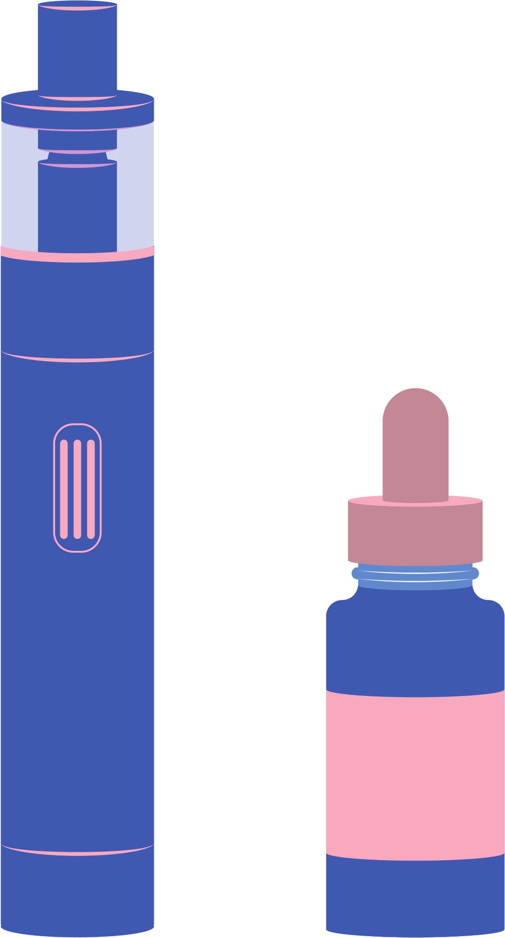
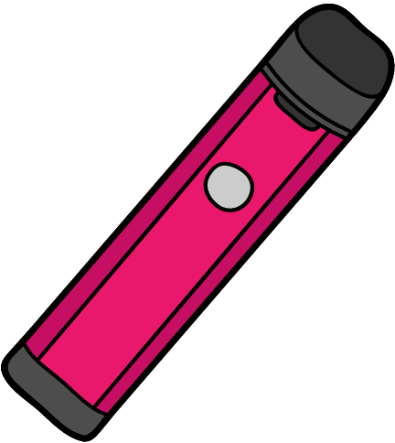
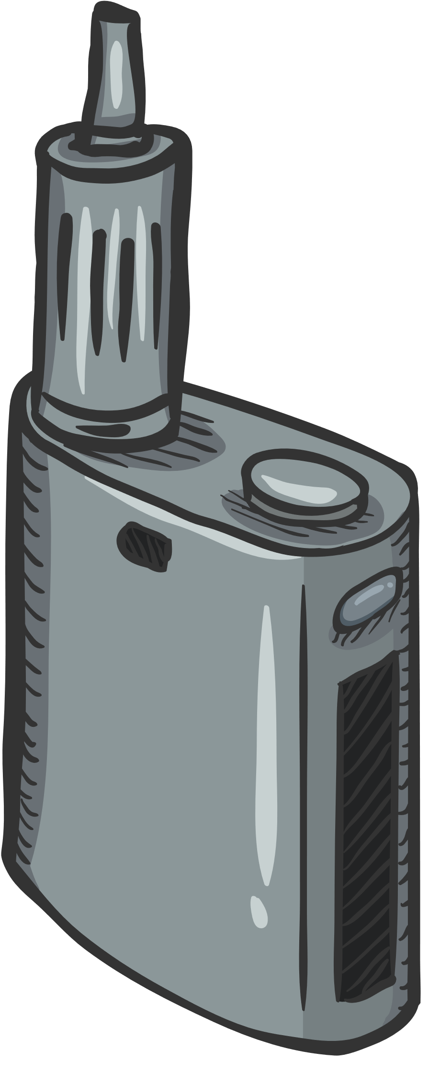
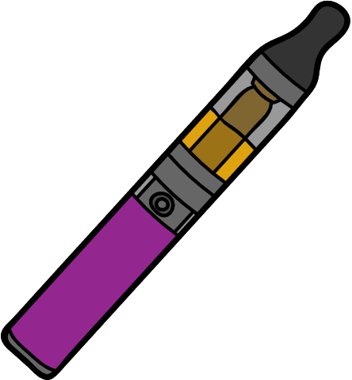
Types of Vapes
Biggest Brand Names
Juul
Puff Bars
Sourin
Supergood
Notes:
Here are just a few examples of different types of vapes.
I'm not going to spend a lot of time going over all the different kinds today, because most of you probably know more than I do about all the different brands.
Vapes or e-cigarettes basically come in 2 varieties which are disposable or refillable.
The smaller disposable kind have become popular because it's easy for you to hide from your parents and teachers.
A lot of adults have no idea what these things look like, and they are made to be hidden. That's part of the reason JUUL took off so massively.
In 2018, JUUL became Sooo Popular, that a lot of people call every kind of vape a JUUL, or they even call using a vape "juuling".
But, regardless of the name, style, size, or ability to be refilled, none of them are safe. You may have heard that it's better than smoking, but we're going to give you some information today that lets you make an informed decision on whether or not it's really any better.

Slide 4
Nicotine Addiction
Notes:
Next up, we're going to get into nicotine addiction, and how it changes your growing brain.
We're also going to tell you some of the harm that comes from this addiction and provide an opportunity to have you make an informed decision during this presentation.

Slide 5
What exactly is nicotine?
Notes:
Nicotine is a poison that occurs naturally in the tobacco plant which gets turned into things like cigarettes, chewing tobacco, and vape juice.
Nicotine unlocks the reward center in your brain. It makes you think you need nicotine the same way you need food and water.
Once your brain and body has developed an addiction to nicotine, you just want that next hit of nicotine.
If you're vaping, you're doing it FOR the nicotine, but you're exposing yourself to whatever else is in that pod or tank.

Slide 6
Is it worth it?
Notes:
We know that even a teaspoon of liquid nicotine can kill a child that is 25 pounds or less. For kids over 25 pounds, even if it doesn't kill them, it can make them very sick and require being put in the hospital.
Before you use these products, you need to think if it's worth it to you.
Is it worth it to make your baby sister or brother sick?
Is getting addicted to nicotine worth hurting someone else?

Slide 7
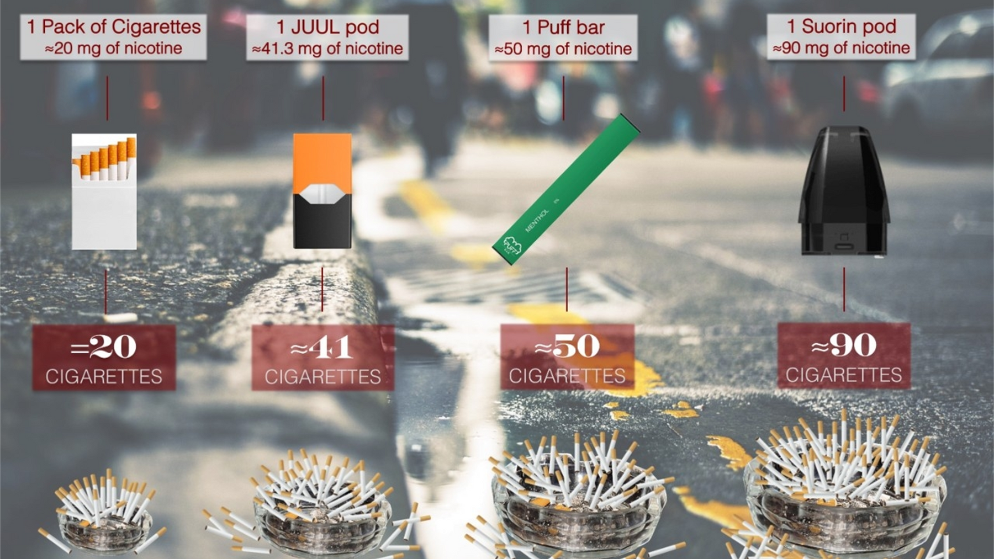
How much nicotine?
Notes:
One way that these companies are working to get you addicted and keep you addicted, is by putting more nicotine into vapes than they EVER have into cigarettes.
If you use one JUUL pod a day, your body has taken in the same amount of nicotine as if you smoked 2 packs of cigarettes.
Those numbers go up with different products. As you can see on this slide, different products are competing to addict you with more nicotine in every hit.
(talk about slide just a little)

Slide 8
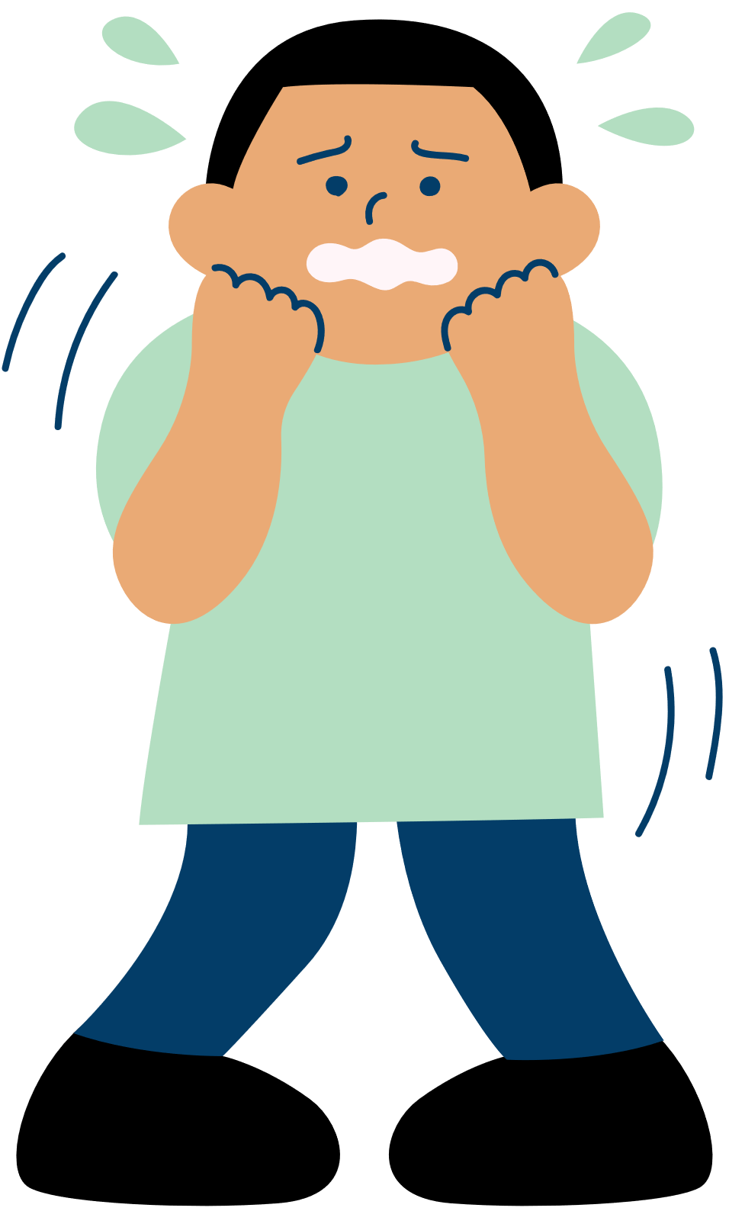
The cycle of nicotine addiction.
Notes:
With as much nicotine as these companies put into these products, it's no wonder people are so easily addicted.
Here you can see the cycle of nicotine addiction, it goes like this: You take a hit off the vape (yellow arrow).
Next it arrives in the Brain in the Frontal Lobe. We're in the dark blue area now. It alters your brain chemistry (that’s when the rush happens.)
It only takes 7 to 10 seconds for the nicotine to get to the brain where it hits the frontal lobe which is the reward center of the brain.
The nicotine releases a rush of dopamine, allowing one to feel the resemblance of relief and pleasure.
This delivers the e-juice (containing heavy metals, flavorings, propylene (pro-pi-lean), glycol, vegetable glycerin, and other unknown substances) and high concentrations of nicotine into the lungs where it then circulates throughout the body in the blood system.
The nicotine effects peak after around 2 hours inviting the onset of withdrawal symptoms. (You start feeling stressed, or anxious irritable and increased depression as the nicotine slowly leaves the blood.
This is referred to as nicotine’s half-life and with frequent use can arrive sooner than the two hours. You see how the guy is freaking out in the light blue spot?
Withdrawal symptoms can cause discomfort and may even be painful. With the body wanting to return to feelings of relief and pleasure, addiction to the nicotine will influence one to return to their source of instant relief, even if it’s not good for them.
This is referred to as the Voice of Addiction. Right there in the red.
Then the cycle starts over again. The more you vape the higher the nicotine levels the sooner you may have to start the cycle over again and again.

Slide 9
Notes:
Did you see what she did in the video?
She literally stuck her hand inside of a public bathroom toilet because she dropped her vape.
Then, she shook the water off of it, and used it before going out of the bathroom.
If that isn't a sign that shows what the addiction of nicotine can do to you? I don't know what is. Because I know I would NEVER get anything out of the toilet and put it in my mouth.
Would you??

Slide 10
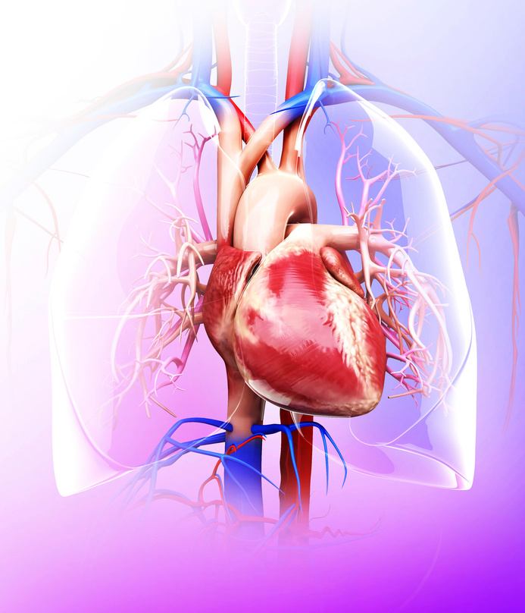
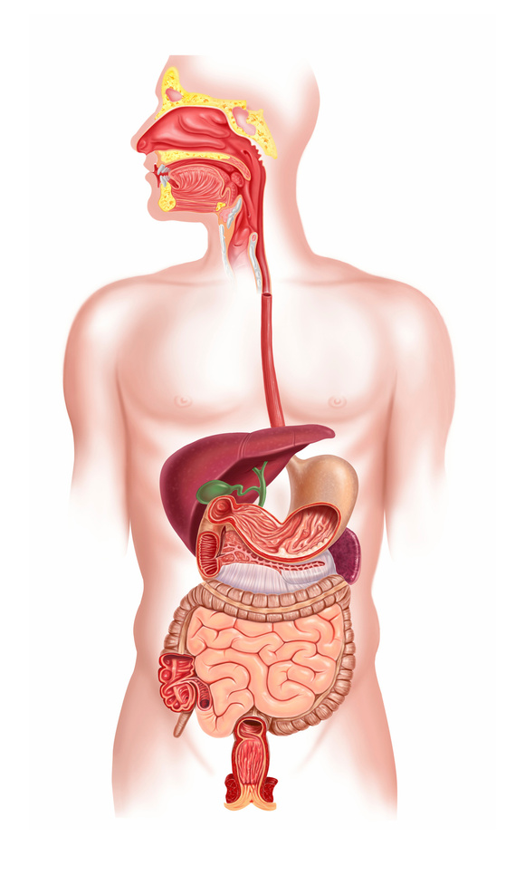
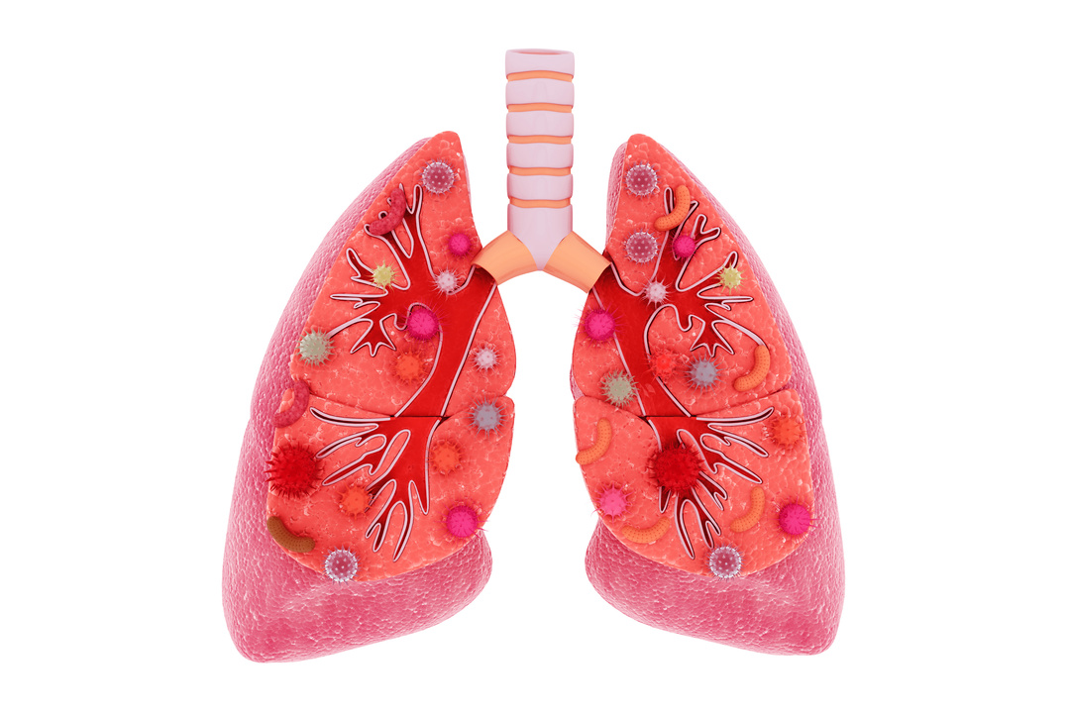
Is it worth it?
Notes:
Even though nicotine itself is dangerous and addictive, the other chemicals in the vape liquid are just as dangerous.
Pretty much every organ of the body can be damaged by vaping. Especially your heart and lungs.
Vaping can give a teenager the same lung capacity as a 70-year-old. If you're someone who enjoys being athletic or having fun outdoors, you need those lungs to function.
Dentists are starting to report gum decay, mouth sores, and tooth decay from teen patients who vape. Trying to keep a nice smile is difficult when your teeth and gums are starting to decay.
Another scary fact about being addicted to vaping, is that if you need surgery, the doctors may choose to wait until you quit before they will do it.
It's dangerous to put someone who can't do the lung function test under anesthesia, so doctors can refuse it. If the surgery is an emergency, then they're taking a real chance with your life when they put you under.
Is it worth it to risk your health and maybe your life because you're addicted to nicotine?
That's a choice you have to make.

Slide 11
Is it worth it?
Explosions belong in action movies, not on your face.
Notes:
Did you know that vapes are known for exploding?
More than 275 cases have been reported of vape explosions.
People have been burned on their faces, hands and other body parts. Some have even lost teeth, and in 2018 a man lost his life due to a vape explosion.
The main link to the explosions has been the batteries inside of them.
Explosions really do belong in action movies, and not on your face and body.

Slide 12
How do they hook you?
Notes:
Now we're going to talk about how do they hook you.

Slide 13
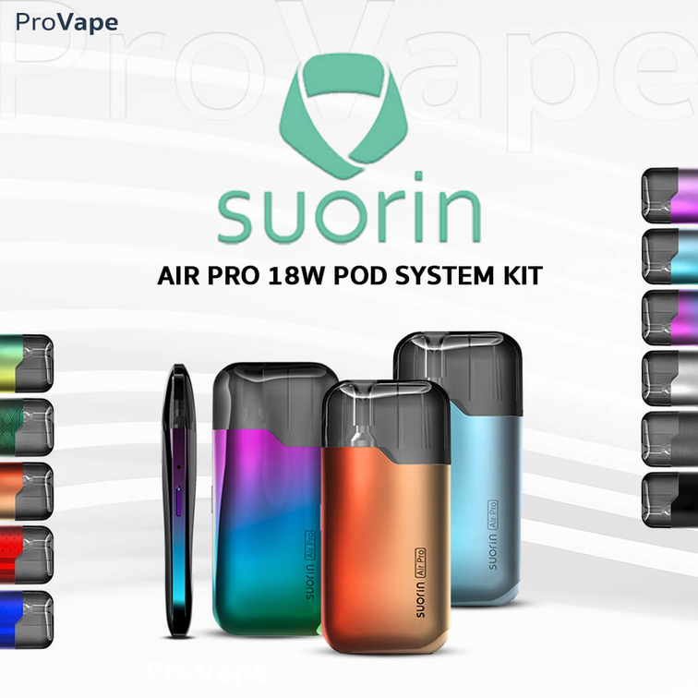
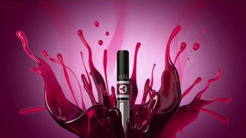
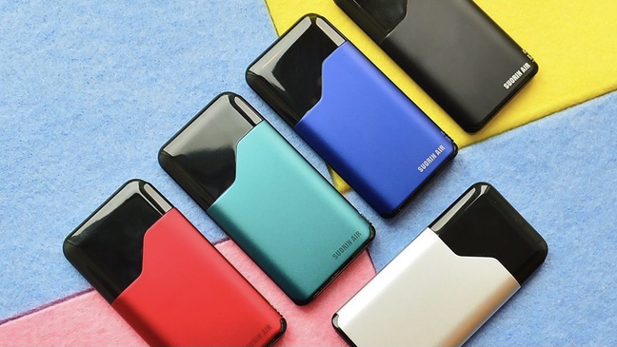
Notes:
You've probably heard the phrase "big tobacco" at some point in your life.
When people say, "big tobacco", they are referring to the multi-BILLION-dollar tobacco industry that has spent many years and many billions of dollars in advertising to hook your parents and grandparents to cigarettes.
What you may not know, is that big tobacco now owns the vaping companies.
So, they have brought all their years of expertise in advertising to YOU, their newest consumer.
They're making their ads bright, fun to look to at, and they of course feature beautiful young people they know you are going to want to look at.

Slide 14
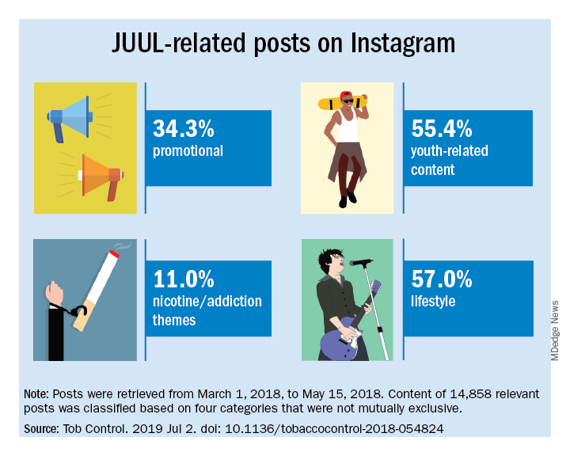
Notes:
Another way they hook you is by using social media. Vape companies are officially banned from advertising on social media, BUT that doesn't stop them.
When you see an influencer you like using vape-related hashtags, that influencer probably got a ton of free merchandise in exchange for that post.
They're not supposed to get paid for these posts, but we know that tobacco companies don't always listen or care about the rules. Your favorite influencer isn't just posting because they like the product. They're always getting something in return.

Slide 15
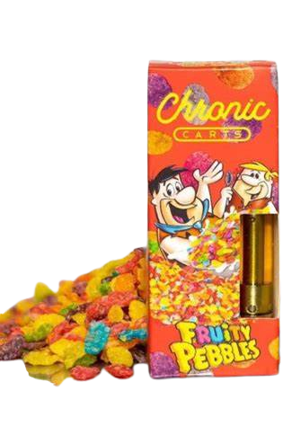
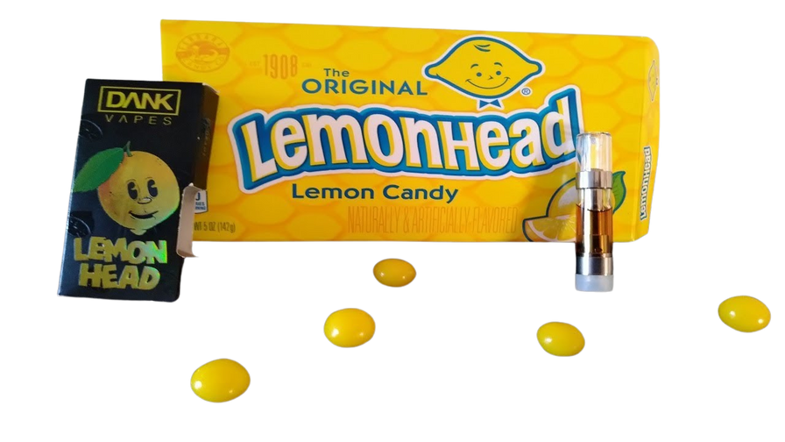
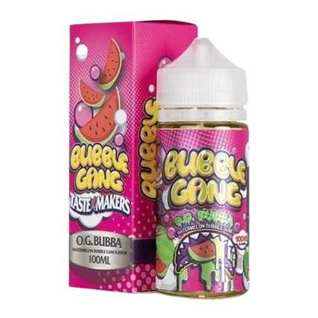
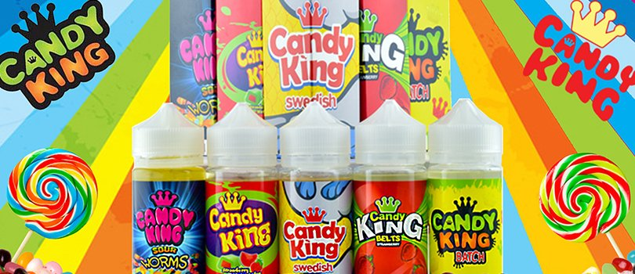
Flavors & Colors
Flavors such as fruit, mint, or different sweet flavors are one of the main targets towards attracting youth to vaping.
Notes:
Another hook? Bright and shiny colors, and fun flavors.
Someone sees something bright and colorful; they're going to look at it. Who doesn't like something that's sweet? Or one of your favorite flavors of candy, drink, or a mixture of both?
Any flavor that you can think of tobacco companies has created it to draw younger people to using their products.
As shown, they have made vapes to mimic some of everyone's favorite type of candies and even cereals.
It is packed full of nicotine and other harmful chemicals.

Slide 16
Who's The Target?
Notes:
Who would be the biggest target? You'd think maybe young adults around 25, or older people because they may already be smokers. But it's not. It's You!
Tobacco companies know that many of their customers are going to die every year. So they have to create new customers. That's you and the kids younger than you. They need new customers to replace the ones that have died.

Slide 17
"Today's teenager is tomorrow's potential regular customer."
"If it was legal to sell to 'em, we'd be glad to. But it's not."
"The smoking patterns of teenagers are particularly important to Phillip Morris."
Notes:
Who are the people running these companies? Tobacco executives. They ran companies that made cigarettes for years, and now they've moved on to vapes.
Here are a few famous quotes from tobacco executives. Remember, this is who you're giving your money to.
"Today's teenager is tomorrow's potential regular customer." Which is YOU..
"If it was legal to sell to 'em, we'd be glad to. But it's not." They're talking about people who are underage smokers.
"The smoking patterns of teenagers are particularly important to Phillip Morris." and he just so happens to sell the best-selling product, Marlboro.

Slide 18
What's The Cost?
Notes:
So, we've discussed the physical effects that vaping will cost you.
Now let's talk about the financial side of what's the cost.

Slide 19
What's The Cost?
One 2-pack Juul Pods/Day @ $12.00
$360.00/Month
$4,320/Year
$17,280 over 4 years in High School
In a 4-year time span, you have vaped the price of a brand-new car.
Notes:
What is the cost you'd pay for your nicotine addiction?
Let's say that you are already someone who is addicted, and you use at least 2 Juul pods a day. And you started vaping early as 9th grade.
2 Juul Pods a day is $12.00. (We'll leave out the tax)
Okay so you do that every day for a month. that is now $360.00.
Let's now say you do this every day for a year. You now have spent $4,320.
Now you have been vaping every day for the last 4 years that you're in high school. and you have now spent $17,280.
That is the price of a Brand new 2022 Kia Forte.
New Car Anyone?

Slide 20
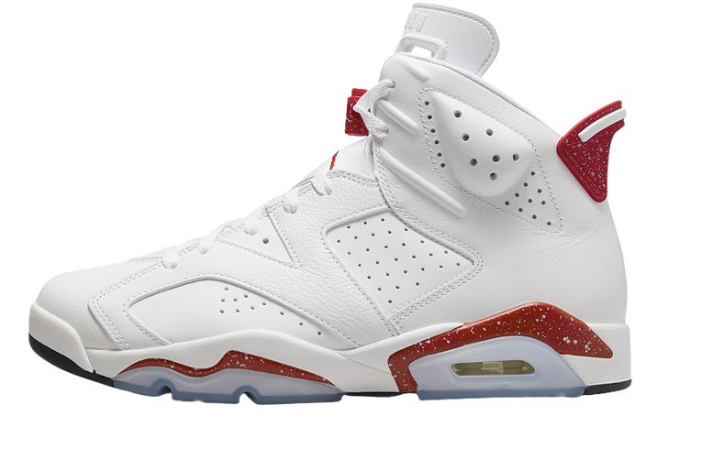
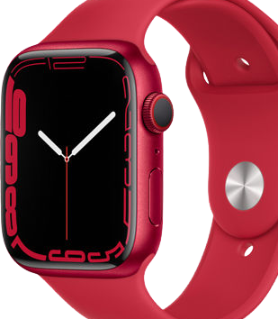
IS IT WORTH IT??
$360 EDITION
Notes:
We've had you ask the question several times, 'is it worth it?" so now let's see what is worth $360. As teens, and not even a teen, me, myself would love to have all of the items on the page. Wouldn't you? Do you think you could buy all of these things with the money that you've spent on nicotine?
Everything on this page is something that you could buy yourself by saving the $360 that you would spend on nicotine a month. One month of nicotine will buy at least one of these things. Is it worth to waste your money on vaping when you could save it and get something else that's not damaging your lungs?
You have your Jordans, Iphone 13, Airpods, Apple Watch, and the Newest Xbox X and PlayStation 5, and there is so much more your money could buy.

Slide 21
How to Quit?
Notes:
Let's talk about How to Quit.

Slide 22
BE WELL ARKANSAS
1-833-283-WELL (9355)
www.bewellarkansas.org
Enroll in a text program from The Truth Initiative: text DITCHVAPE to 88709.
Notes:
Everyone knows someone who smokes cigarettes, e-cigarettes, and or vape.
You may also call Be Well which is a FREE tobacco quit line in Arkansas. Teens ages 13-18 are allowed to call for counseling services. (All your information is protected and private) Any teen over the age of 18 can call the Quitline to enroll in counseling services as well as to receive nicotine replacement therapy.
You can also enroll in texting services with the Truth Initiative by texting ditchvape to 88709.

Slide 23
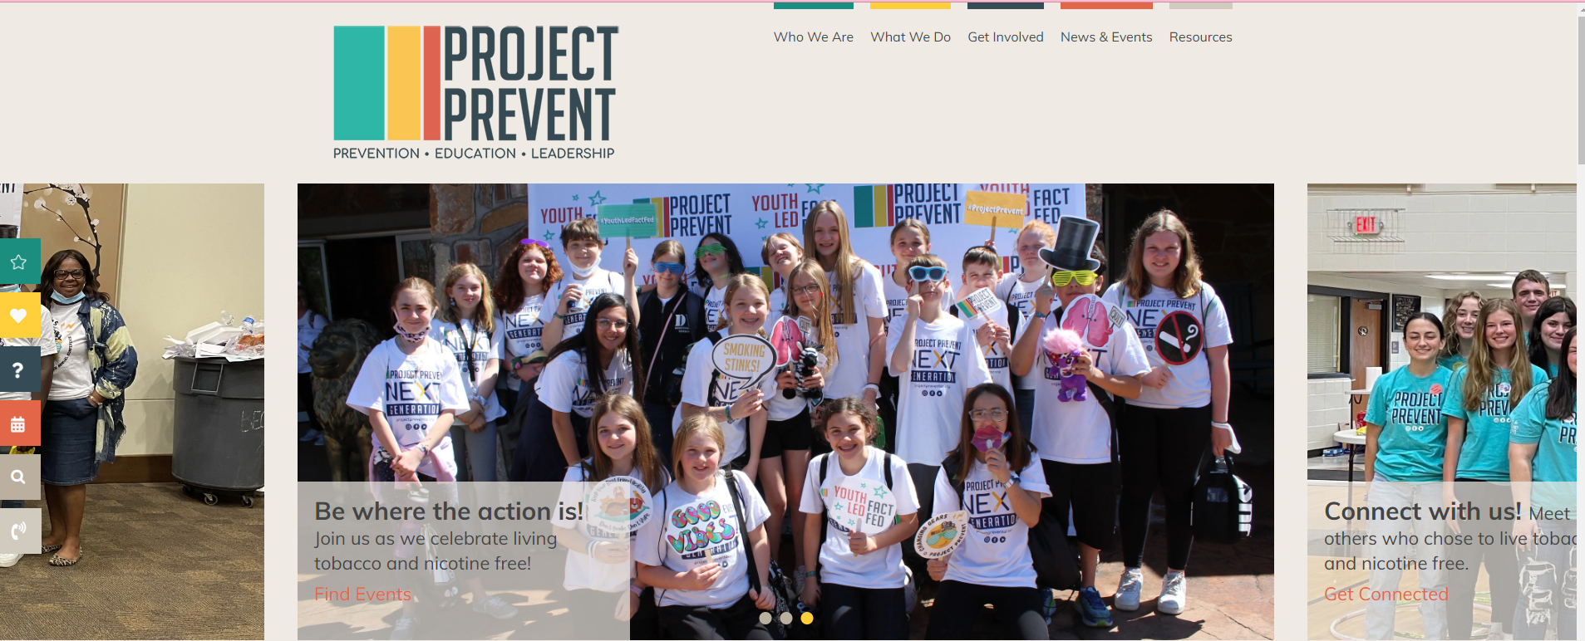
Project Prevent is the statewide youth tobacco prevention coalition in Arkansas.
Their chapters choose to live their lives free from tobacco and nicotine and encourage others to do the same.
Go To: https://projectpreventar.org/
Notes:
We also have a program here in Arkansas called Project Prevent.
It is a Youth Collation Program is the statewide tobacco prevention collation in Arkansas. This is a great interactive program.
Their members and chapters across the state choose to live a tobacco and nicotine free life and encourage others to do the same.
Project Prevent believes that youth have the power to change social norms. They provide young people with knowledge and support to combat tobacco and nicotine through three pillars: Prevention, Education, and Leadership.
You can go to their website listed to get all the great details, upcoming events, and much more.

Slide 24
Notes:
Any Questions?

