Slide 1
LET'S LEARN ABOUT
VAPING
&
E-CIGARETTES
Notes:
This presentation is for grades 5-8.

Slide 2
TODAY'S GUIDE
Let's talk about it
What is A Vape?
Nicotine Addiction
How They Hook You?
What Is the Cost?
How to Quit
Notes:
Today we are going to talk about some things that you may already know, and some things that will be new to you.
Like what is a vape, what is nicotine addiction, how they hook you, what is the cost, and how to quit.
The goal for today is to make sure you have learned about vaping, what it does to your body, and how to make choices for yourself.

Slide 3
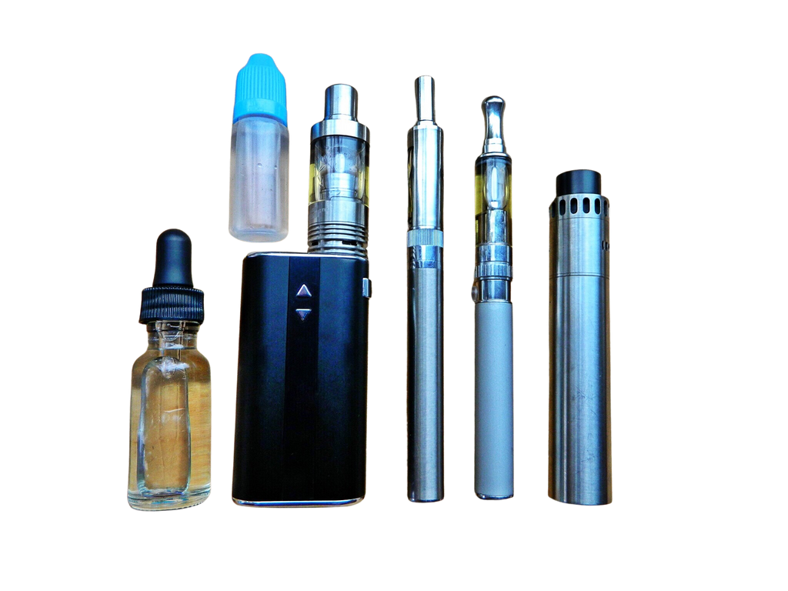
WHAT IS A VAPE?
A "vape," or an electronic cigarette, is a device that heats up a liquid to create a vapor you inhale.
Notes:
A vape or an electronic cigarette (or e-cig for short) is a small device that looks like a pen or USB drive that uses a battery to heat up a liquid to make a big cloud of smoke that you breathe in which is called vapor.
This is how it gets the nickname "vape."

Slide 4
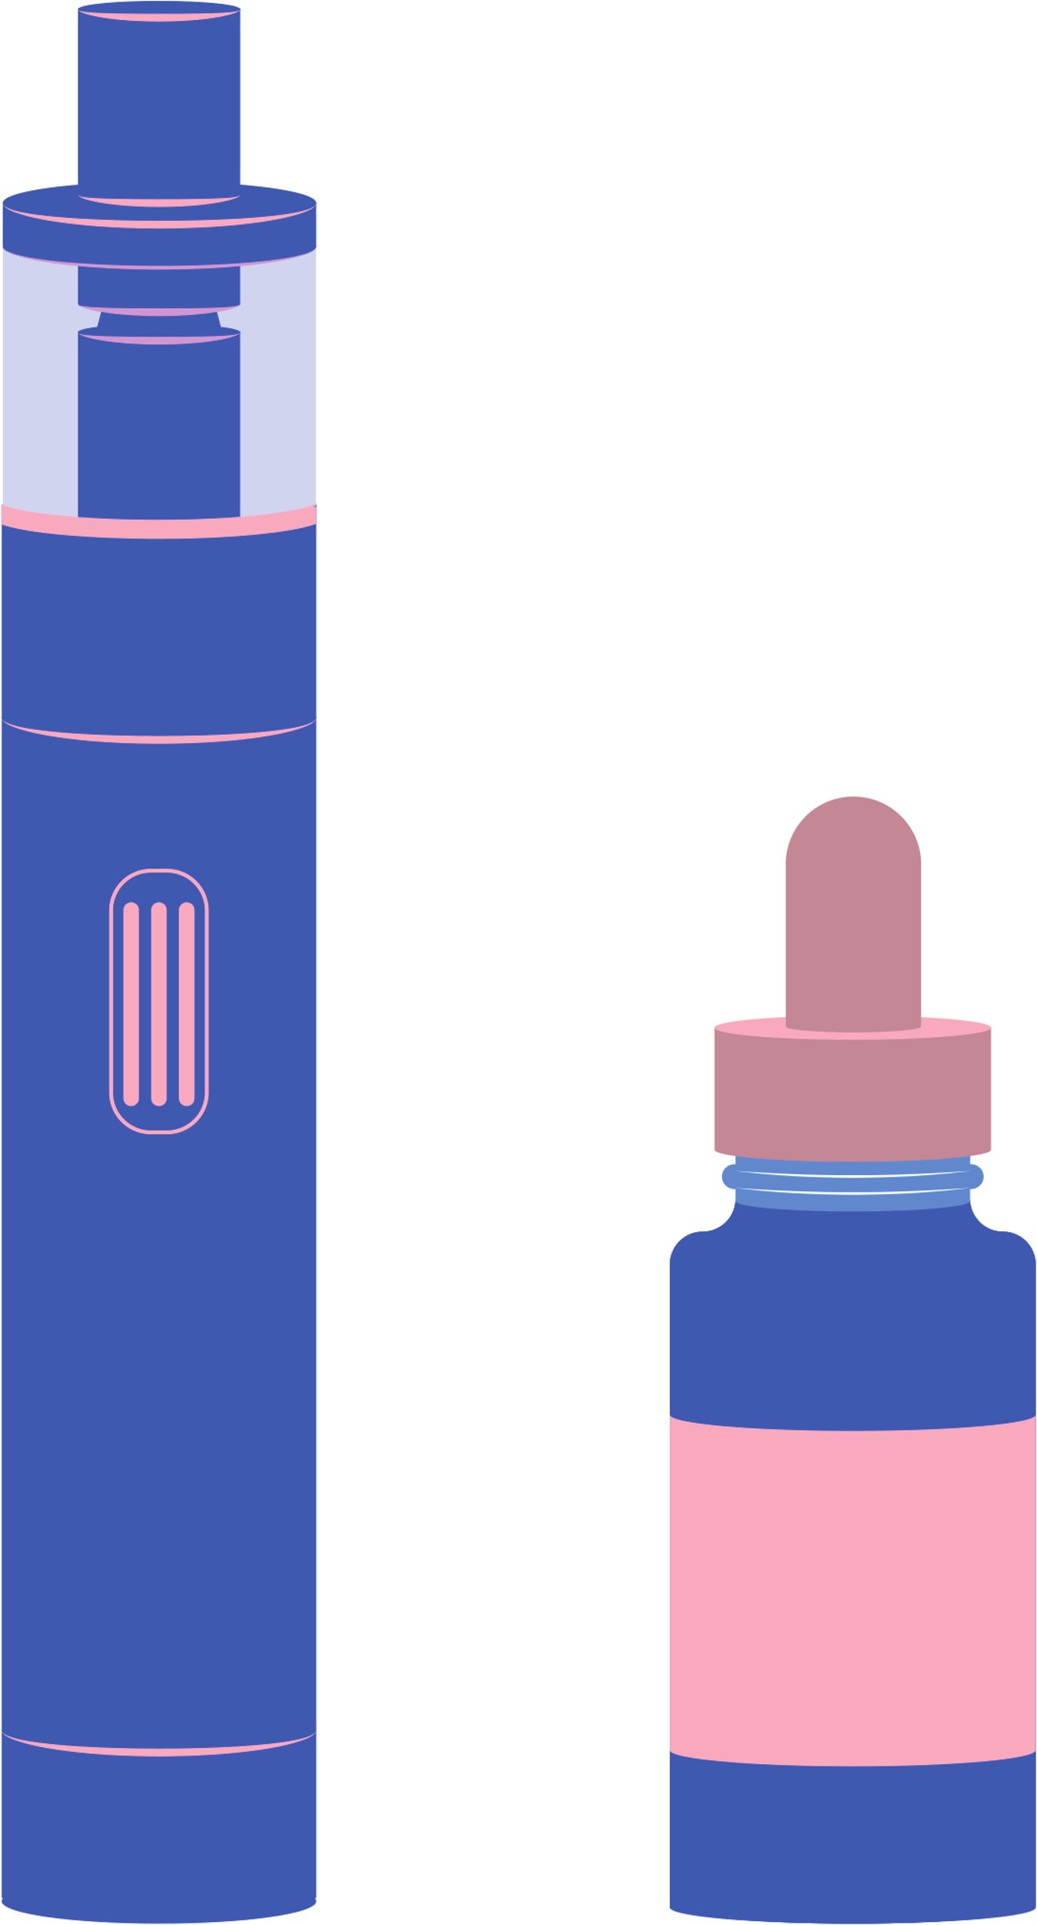
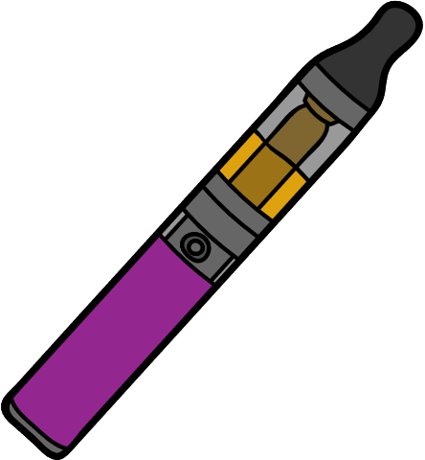
TYPES OF VAPES
Common Brand Names
juul
puff bars
Suorin
supergood
Notes:
Vapes come in different sizes, shapes, and colors.
Some of you probably know more about the different brands than I do. Then some of you may just have heard the names before. Such as Juul, Suorin, Puff Bars, and Supergood to name a few.
Vapes or e-cigarettes come in 2 styles.
One of them is called a disposable or "throw aways". These are the most popular because they're easier to hide from anyone and when they're done, they just throw them away.
Then there are the ones you buy a new piece for which is the flavoring, and it can charge it which is called a refillable.

Slide 5
What is
NICOTINE ADDICTION
Notes:
Next up, we are going to talk about nicotine addiction, what it is, and how it changes your growing brain.
I'm also going to tell you some of the harm that comes from this addiction and things you need to know to make a great decision.

Slide 6
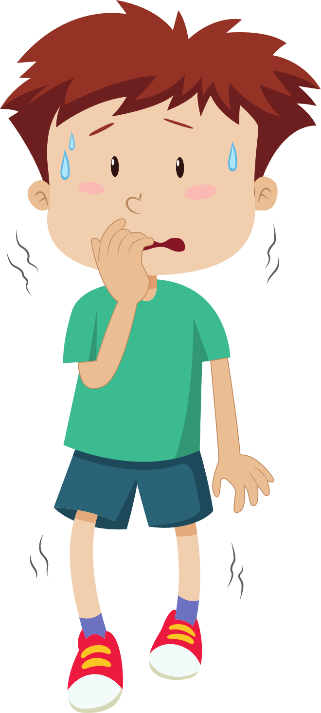
WHAT EXACTLY IS NICOTINE?
It's a poisonous chemical found in a plant called tobacco. It is put inside cigarettes and vape liquids, and it makes you want more of it.
Notes:
I know you all may or may not have heard of nicotine. Just cigarettes or vaping.
Nicotine is a poisonous chemical that is broken down from a plant called tobacco. It's very addictive and is how people develop addictions or hook you to it.
Nicotine causes you want to move around all the time, can't be still, make you talk a lot, and feel nervous.
It's so poisonous, if a little kid (like you if they're small kids) swallows a teaspoon (or like a spoon you use to eat cereal with), it can kill them.
And we don't want that do we?

Slide 7
WHAT DOES NICOTINE DO TO YOU?
It effects your developing brain and harms parts that controls:
Learning
Your Mood
Paying Attention
Attitude Control
Notes:
Nicotine releases bad chemicals to your brain that makes you want it more than anything, even more than you want food or drinks.
Once it has gotten into your brain and body, it begins to make you start to feel funny. You won't be able to learn or remember things like you used to either.
Your mood will change, and you will become meaner and angrier, sometimes even sad and you won't know why.
You won't be able to pay attention well, and you won't be able to control your attitude.
If you're vaping, you're doing it FOR the nicotine, but you're exposing yourself to a lot of other chemicals that will hurt you.

Slide 8
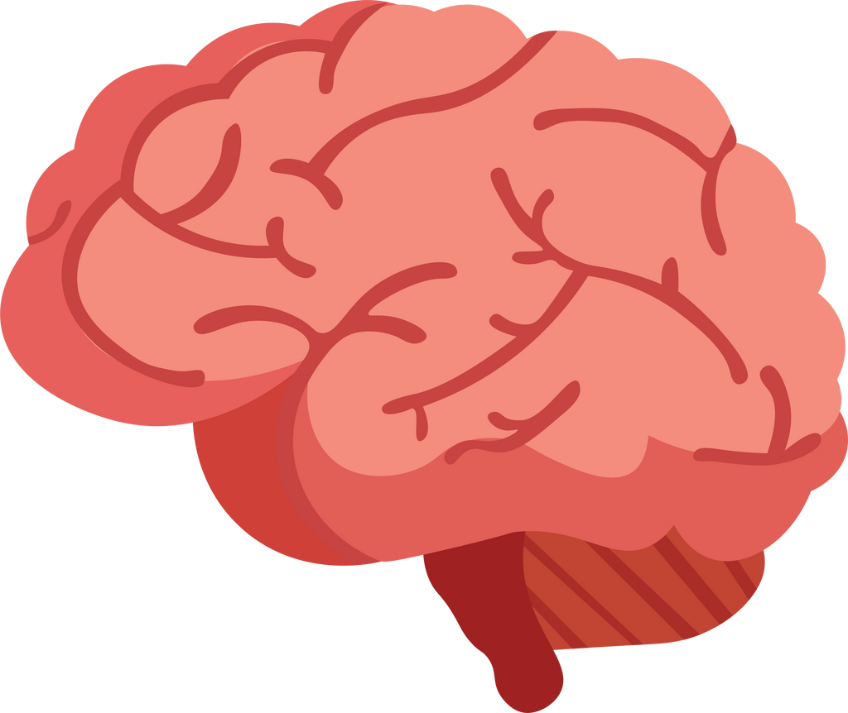
the cycle of nicotine addiction
Notes:
Let's talk about how nicotine addiction works. We're going to go over the color wheel you see here.
First, we have the vape in the yellow.
Next, we have your big, smart, brain in the purple. When you vape, it causes a rush type of feeling like you would when you're hanging upside down on the monkey bars for too long.
It travels to your brain as fast as you can sing the first line of Old McDonald Had a Farm. Thats really fast.
The more that you use the vape or e-cig, the more you want it, and when you don't have it, makes you freak out like the guy in the pink when you don't have it.
When you stop using it, it makes you feel sick, and sometimes it makes your body and head hurt. So, your brain and body are screaming at you loud like a microphone to do it again to get rid of those bad feelings just like what you see in the light orange color.
This is how a nicotine addiction or habit is beginning. Then the cycle starts over again.

Slide 9
Notes:
Did you all see what she did in the video?
She stuck her hand inside of a toilet because she dropped her vape. She wanted it that bad.
Then, she shook the water off of it, and used it before going out of the bathroom. Putting water from the toilet in her mouth. Can you imagine how gross that is?
That is a HUGE sign that shows what the addiction of nicotine can do to you. Because I know I would NEVER get anything out of the toilet and put it in my mouth.
Would you??

Slide 10
VAPES HURT YOU
EXPLOSIONS BELONG IN ACTION MOVIES, NOT ON YOUR FACE.
Notes:
Did you know that vapes are known for exploding?
People have been burned on their faces, hands and other body parts. Some have even lost teeth, and in 2018 a man lost his life due to a vape explosion.
The batteries inside them are what makes them explode.
Explosions really do belong in action movies, and not on your face and body.

Slide 11
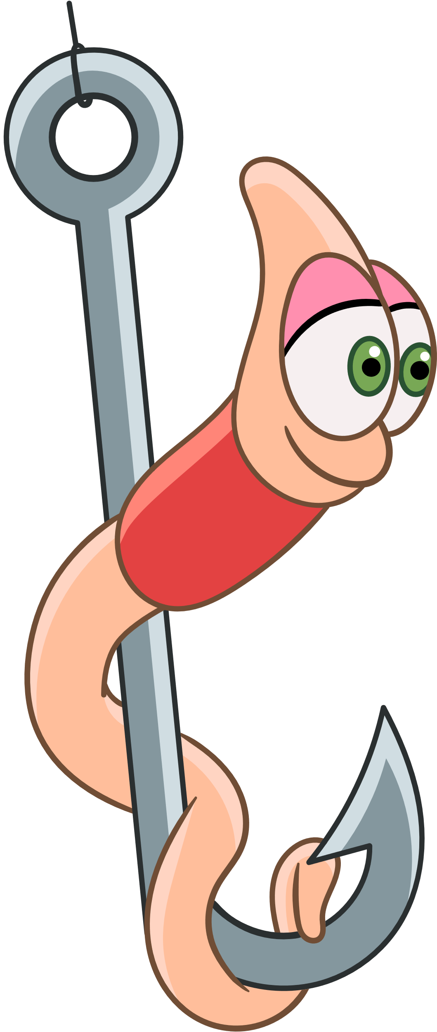
HOW DO THEY HOOK YOU?
Notes:
Now let's talk about the different ways that they hook you.

Slide 12
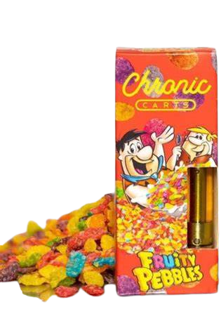
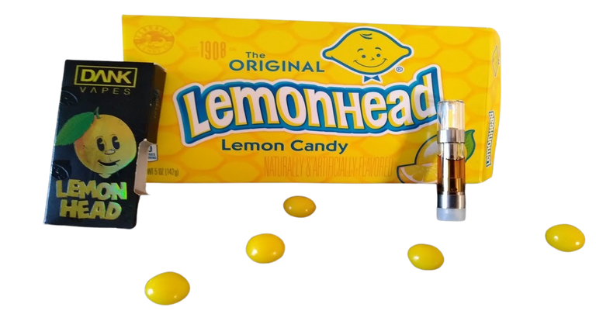
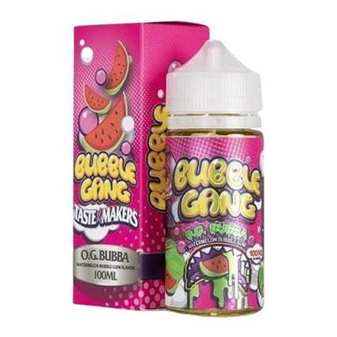
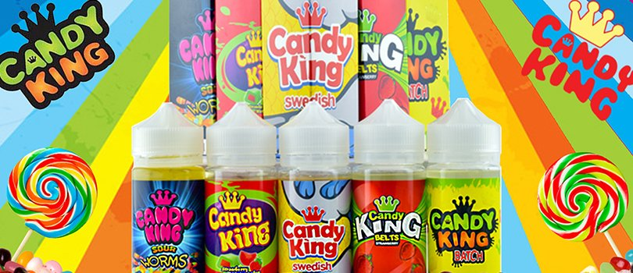
Flavors & Colors
Flavors such as fruity, minty, or different sweet flavors are one of the main targets towards attracting youth to vaping.
Notes:
They hook you by bright colors, your favorite candies, and even your favorite cereals.
If you look here, all of these are candies you would see in the store. But these shown are not candy.
They are vaping juices to look just like candy.
They are packed full of nicotine and other harmful ingredients to hurt you.
It's best to stay away from these vaping juices and vapes all together. It looks fun, but it's not.

Slide 13
Who's The Target?
Notes:
Who would you think these companies make these things for? Grown-ups like your mom and dad, grandparents, or someone older because they may already be smokers. But it's not. It's YOU!
Yes! As young and small as you are, you are the target for many reasons.
At the age you are now, it's easy to show you something pretty, fruity, to make you like it, especially when other kids think it is "cool."
The people who make them, pay attention to things kids your age like, your favorite colors, the words you use, and adding them secretly into your everyday life.

Slide 14
Notes:
Since we spoke about how they hook you, flavors, and who's the main target.
Now, let's watch this video and see what you think about this.
**watch video
So, after watching the video, you see how parents thought that their kids were getting ice cream when it was really nicotine?
This how easy the companies are trying to make it to where they can give it to kids and can hide it from their parents and putting it into some of your favorite things just like ice cream.

Slide 15
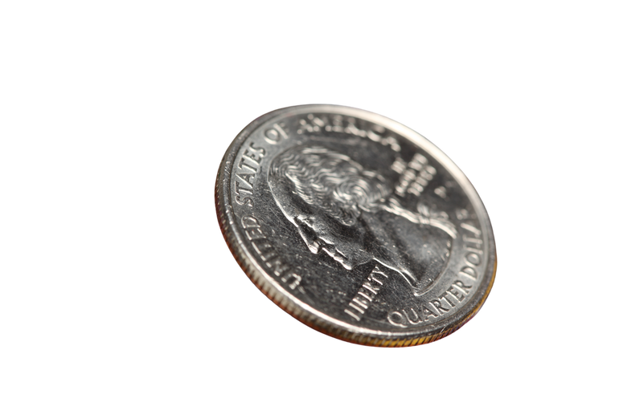
WHAT'S THE COST?

Slide 16
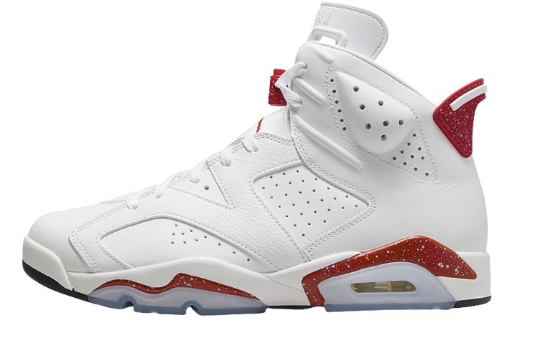
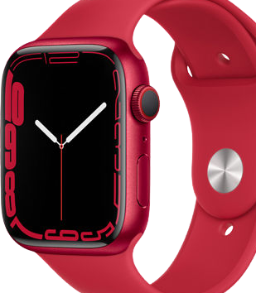
WHAT'S THE COST?
$360 EDITION
Notes:
On an average, a person smokes at least 2 Juul Pods a day which is $12.00.
Here's a little math before I get started so you know how I got this amount. Let's say someone smokes at least 2 pods a day for 30 days. that would be:
$12x30=360.
So, in a month's time of vaping, you would spend $360.
Wouldn't any of you like to have any of the things you see here? I know I would love to have the newest iPhone.
Everything on this page is something that you could buy yourself by saving the $360 that you would spend on nicotine a month.
Is it worth it to waste your money on vaping, when you could save it and get something else that's not damaging your lungs and body?
You have your Jordans, Iphone 13, Airpods, Apple Watch, and the Newest Xbox X and PlayStation 5, and there is so much more your money could buy.

Slide 17
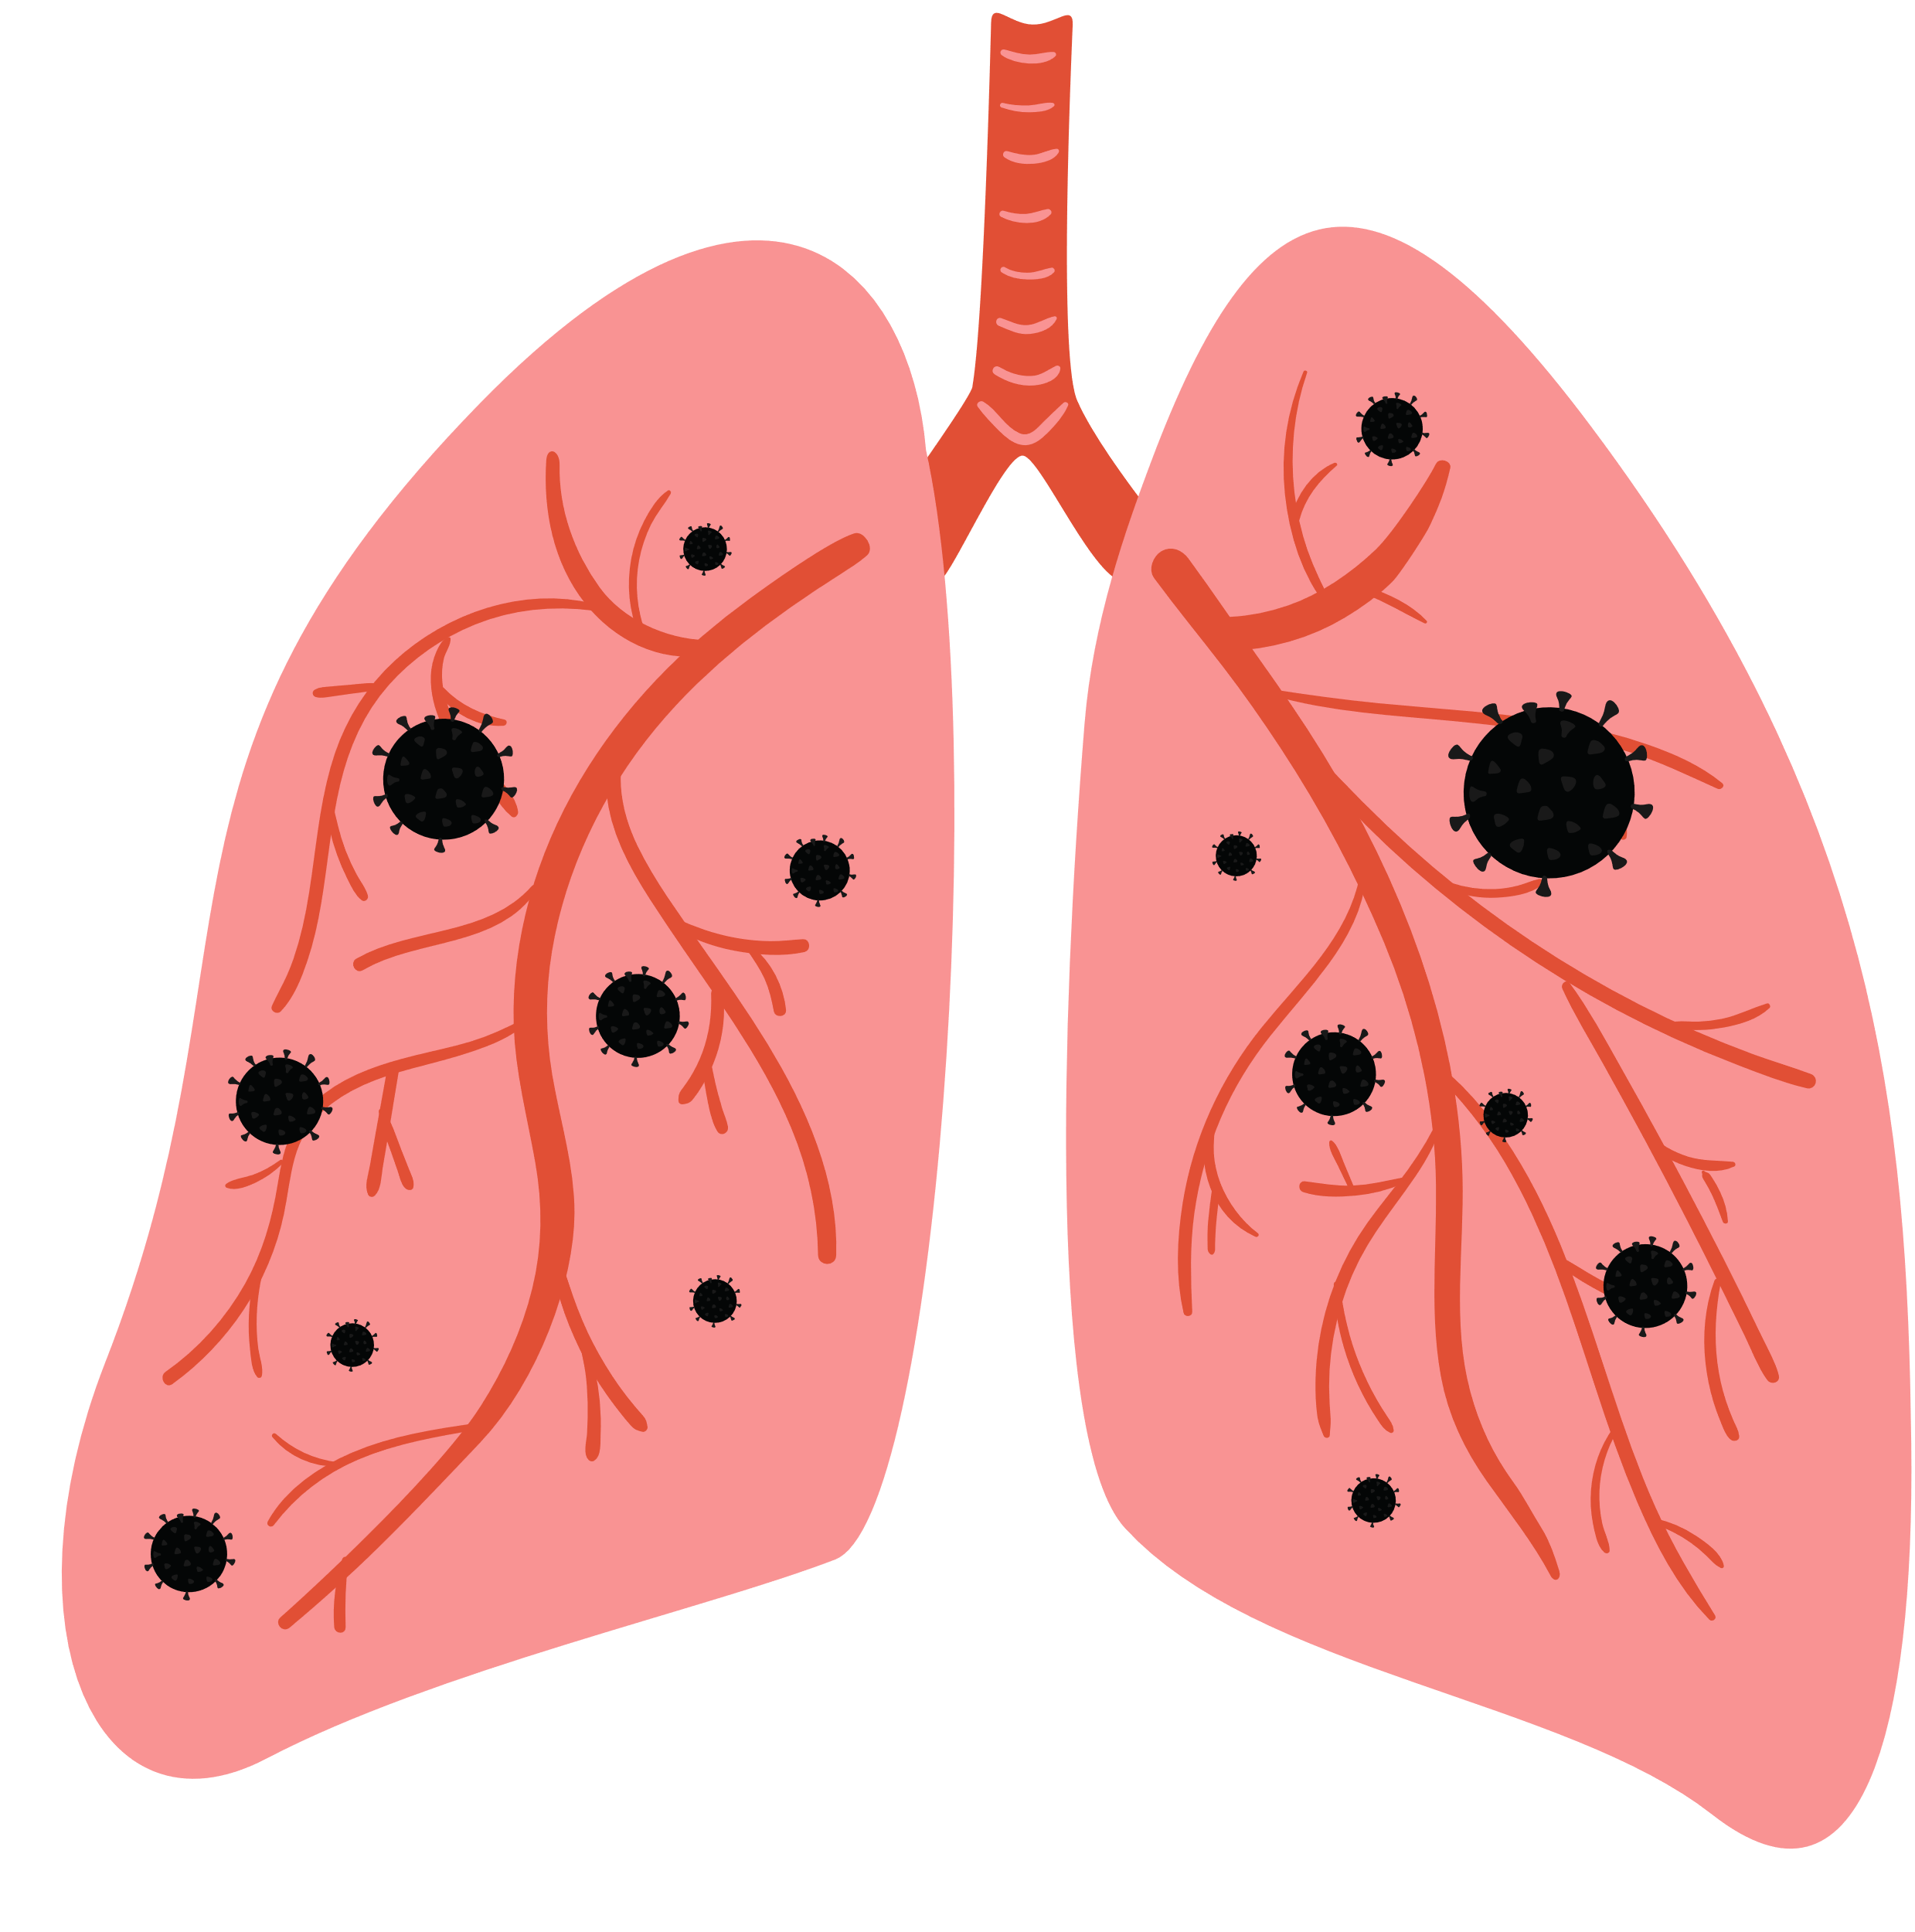
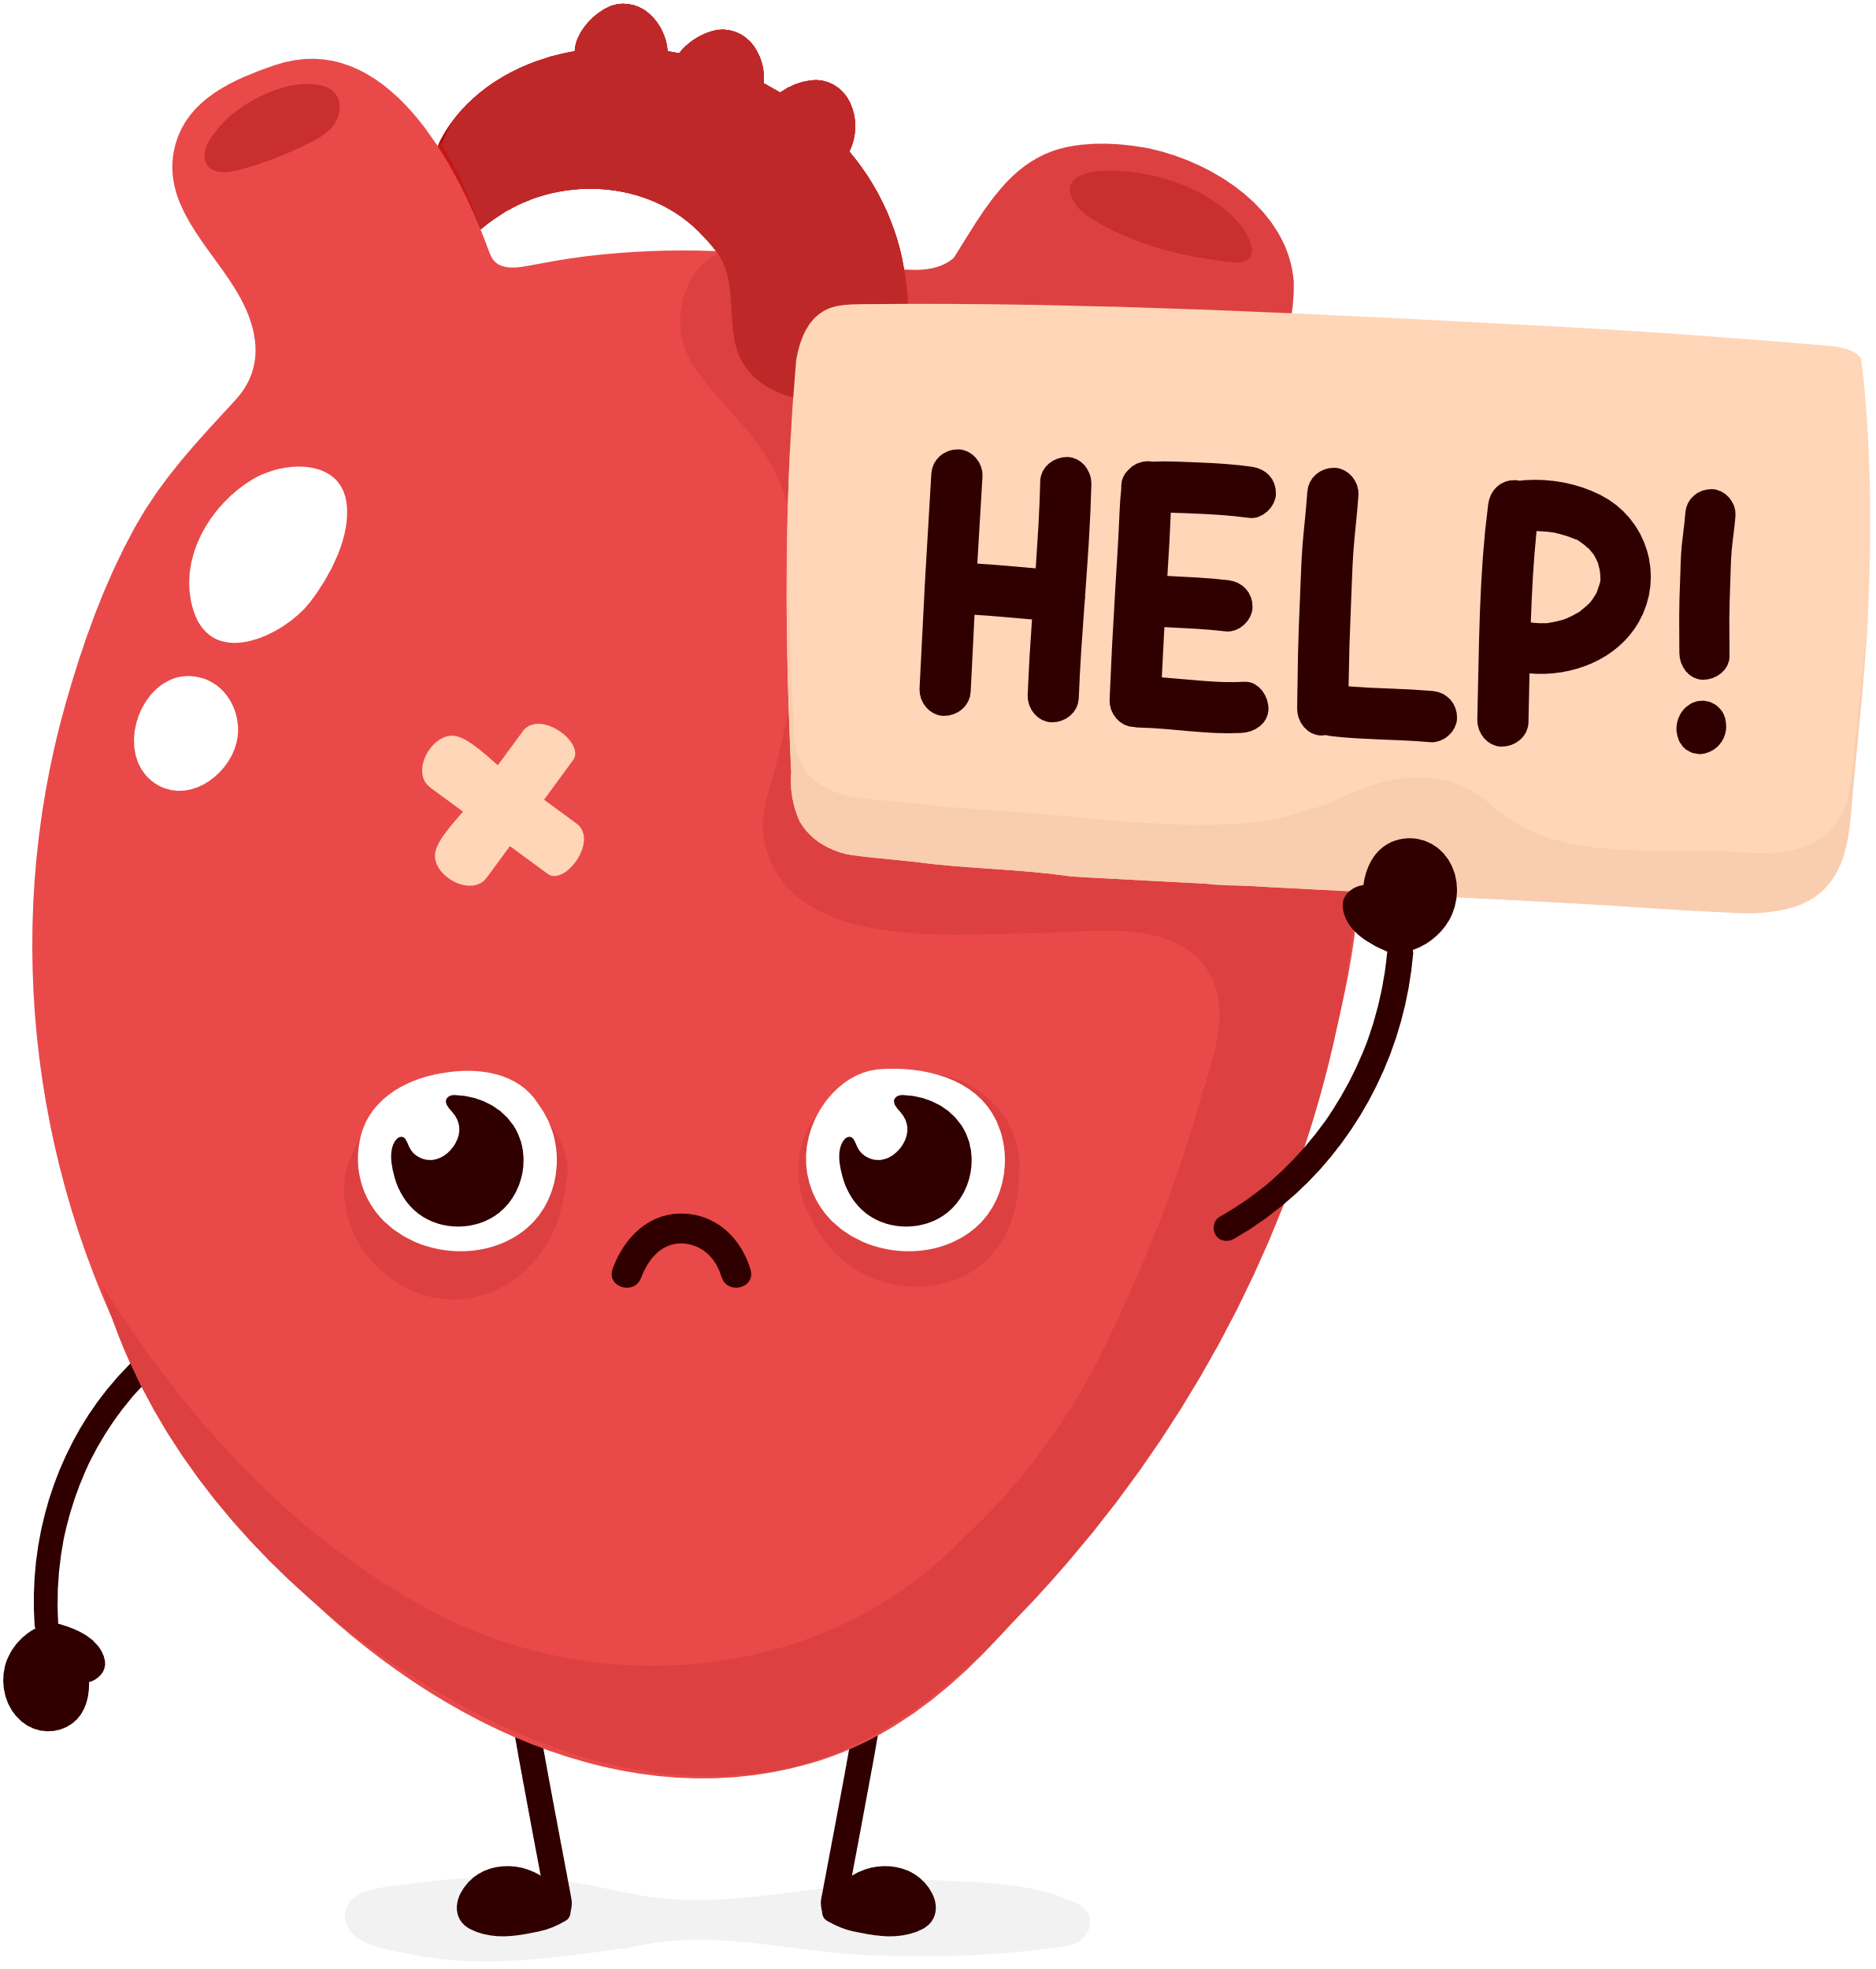
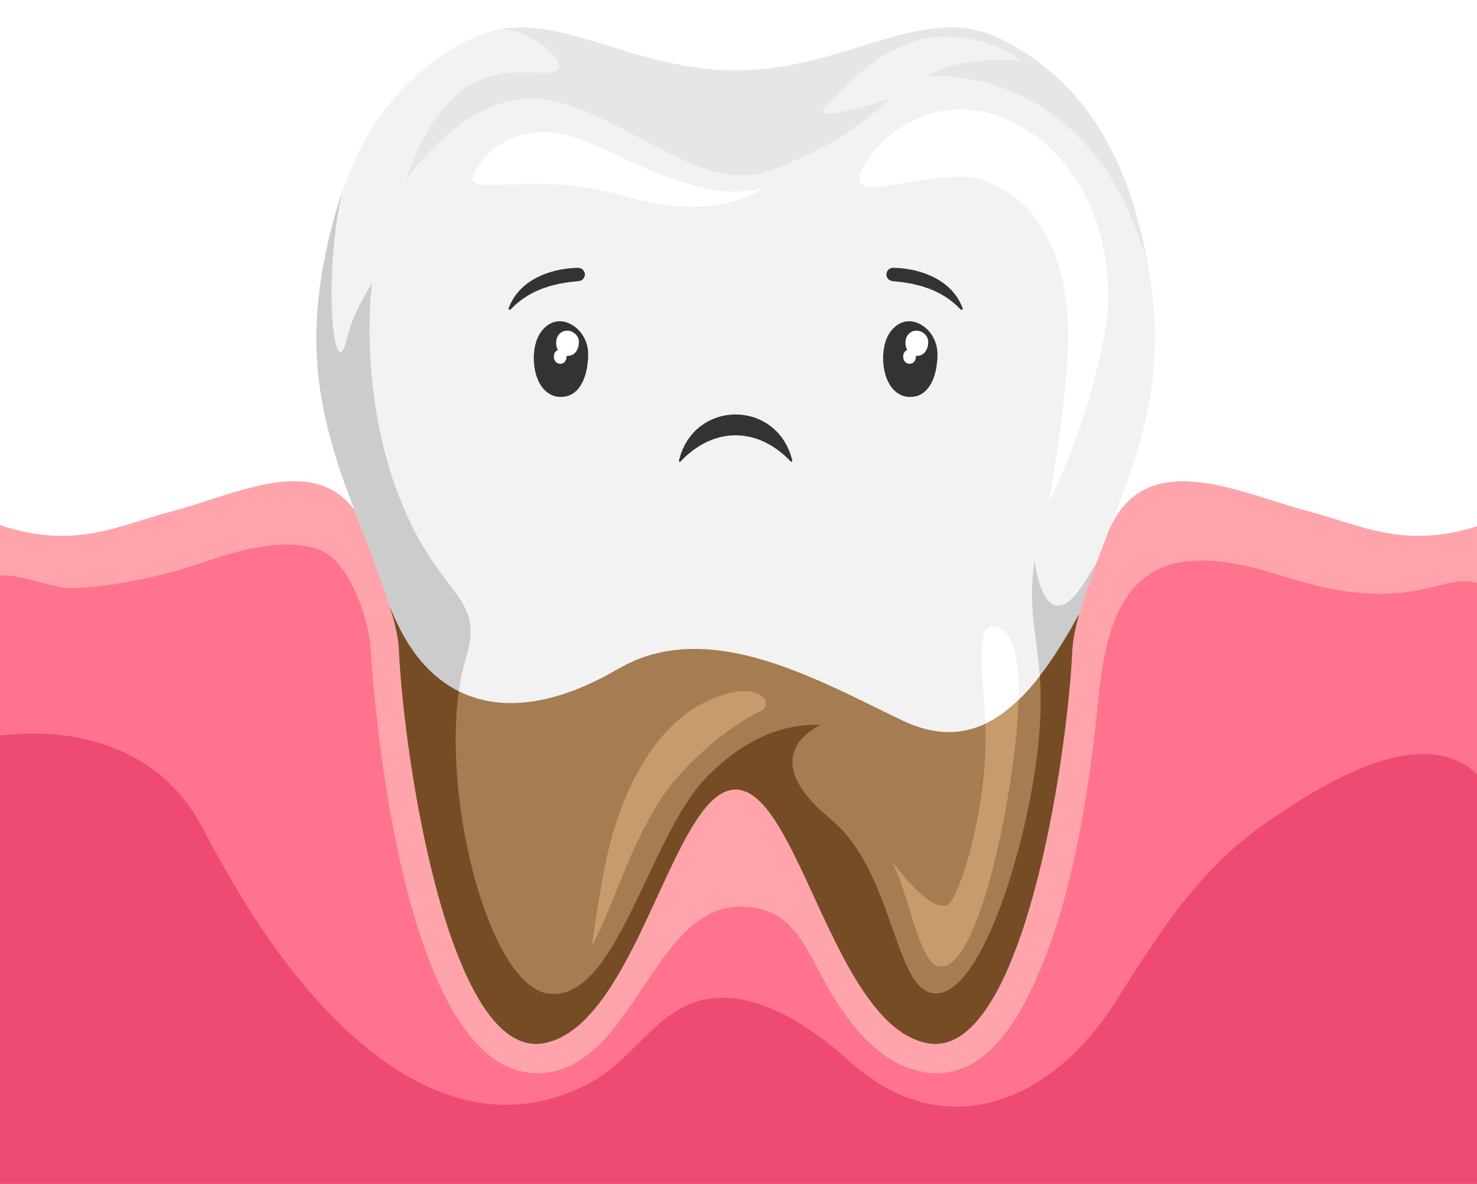
Your health is a big price to pay
Smoking will put your entire body at risk.
Especially your lungs, teeth, and your heart.
Notes:
What else is a cost?
Your Health is a big price to pay just to vape or smoke a e-cigarette.
It doesn't just affect your brain, it affects your body, your teeth, your lungs, and your heart.
All the main things that you need to live a healthy life.
Your teeth start to rot and fall out, making it harder for you to eat normal foods.
Your lungs are what helps you breathe easily. By vaping, it'll make it harder for you to breathe, you wouldn't be able to play, run, jump, and have fun.
Then it makes your heartbeat faster, harder to pump blood through your body and to keep up with all the bad things in your body.

Slide 18
IS IT WORTH IT?
Notes:
Now we have to ask ourselves, is it worth it?

Slide 19
IS IT WORTH:
DOCTORS REFUSING SURGERIES FOR SMOKERS
DENTISTS PULLING YOUR TEETH
DEVELOPING ASHTMA AND OTHER BREATHING ISSUES
Notes:
Along with the big prices to pay, did you know that doctors will refuse to perform surgeries on you due to you having nicotine in your system?
In emergency situations, they take the risk of performing the surgeries with the chance of something wrong happening.
Dentists will pull your teeth as they begin to decay or rot in your gums. This is also an issue coming from gum disease that you develop from smoking/vaping.
Who wants to have problems breathing if they can prevent it? having asthma isn't fun. It is something common that some people deal with due to allegories, grass, dust, and other things. but getting asthma from smoking is so much worse and more painful.
So, is it worth it for your life to be limited to what you can and cannot do?

Slide 20
HOW TO
QUIT
What to do
Notes:
Let's talk about How to Quit.

Slide 21
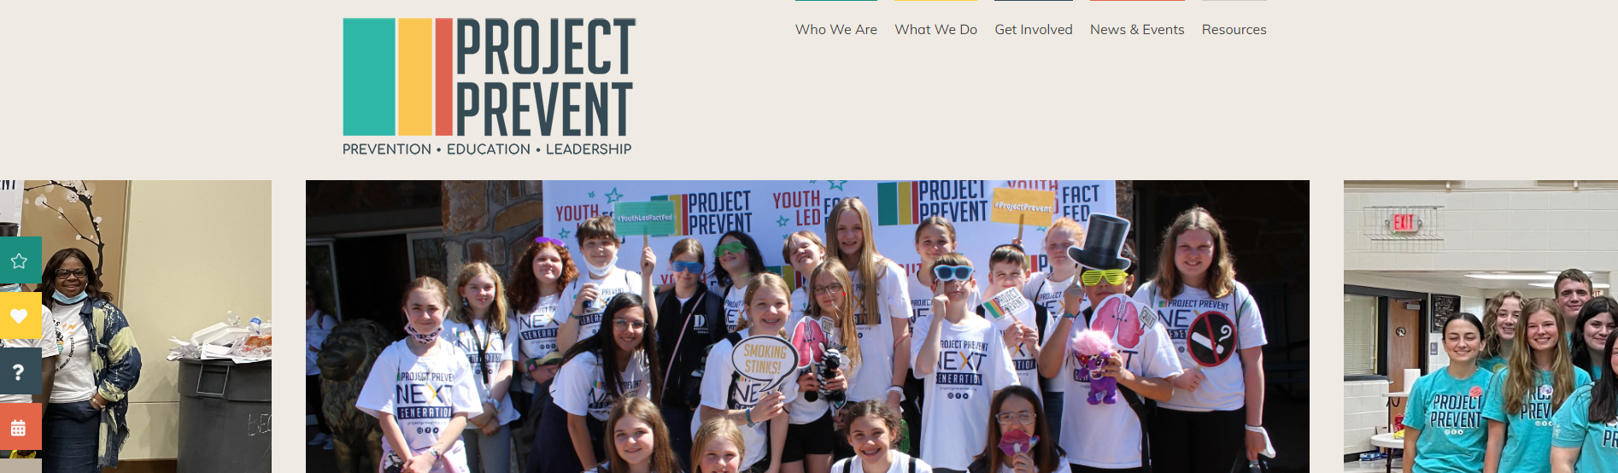
Go To: https://projectpreventar.org/
Project Prevent is the statewide youth tobacco prevention collation in Arkansas.
Their chapters choose to live free from tobacco and nicotine and encourage others to do the same.
Enroll in a text program from The Truth Initiative:
text DITCHVAPE to 88709
Notes:
For your age group, you can text ditchvape to 88709 for help quitting. You can also talk to a trusted adult and ask for help.
We also have a program here in Arkansas called Project Prevent.
Their goal is to live a nicotine free life and make sure all kids know what to do to prevent it or quit.
You can go to their website listed to get all the great details, upcoming events, and much more.

Slide 22
questions??

